Slide 1
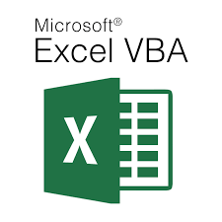
Visual Basic for Application - Theoretical (Lecture 4)
Written By: Kim M Pambid
Reference:
https://learn.microsoft.com/en-us/
https://www.wallstreetmojo.com/
https://www.automateexcel.com/
https://stackoverflow.com/
https://www.wikipedia.org/
https://www.techonthenet.com/

Slide 2
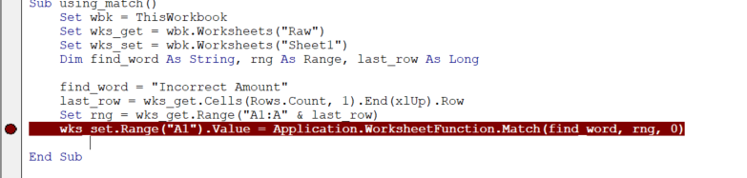
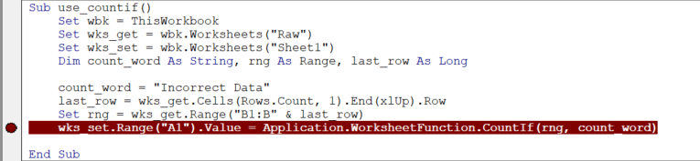
A. Application.Worksheetfunction
A.1. Match - returns the position of the matched value within lookup_array, not the value itself.
A.2. Countif - is a function that counts the number of cells based on the criteria you specify.

Slide 3
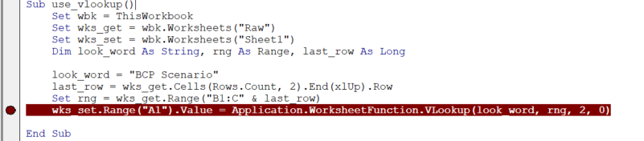
A.3. Vlookup - is a premade function in Excel, which allows searches across columns.

Slide 4
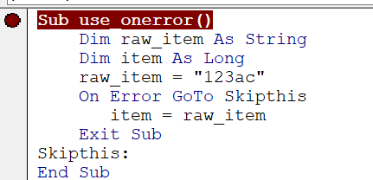
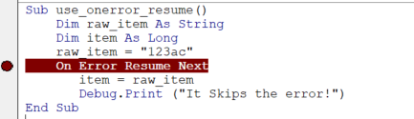
B. Try Catch / Check and Skip Error
B.1. On Error GoTo- Enables the error-handling routine that starts at line specified in the required line argument.
B.2. On Error Resume Next - Specifies that when a run-time error occurs, control goes to the statement immediately following the statement
where the error occurred and execution continues.

Slide 5
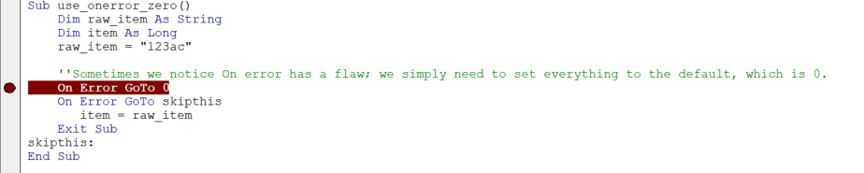
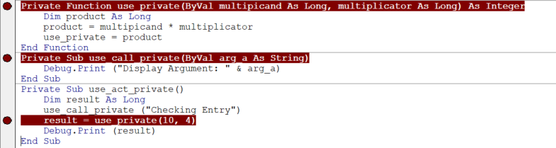
B.3. On Error GoTo 0 - Disables any enabled error handler in the current procedure.
C. Calling Private / Public Subroutine and Functions
C.1. Private Subroutine/Functions - Can only be accessed and changed within the same Module.

Slide 6
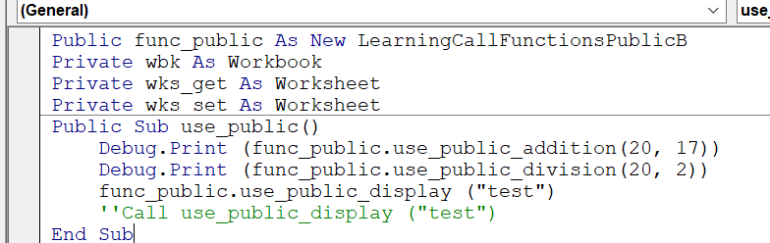
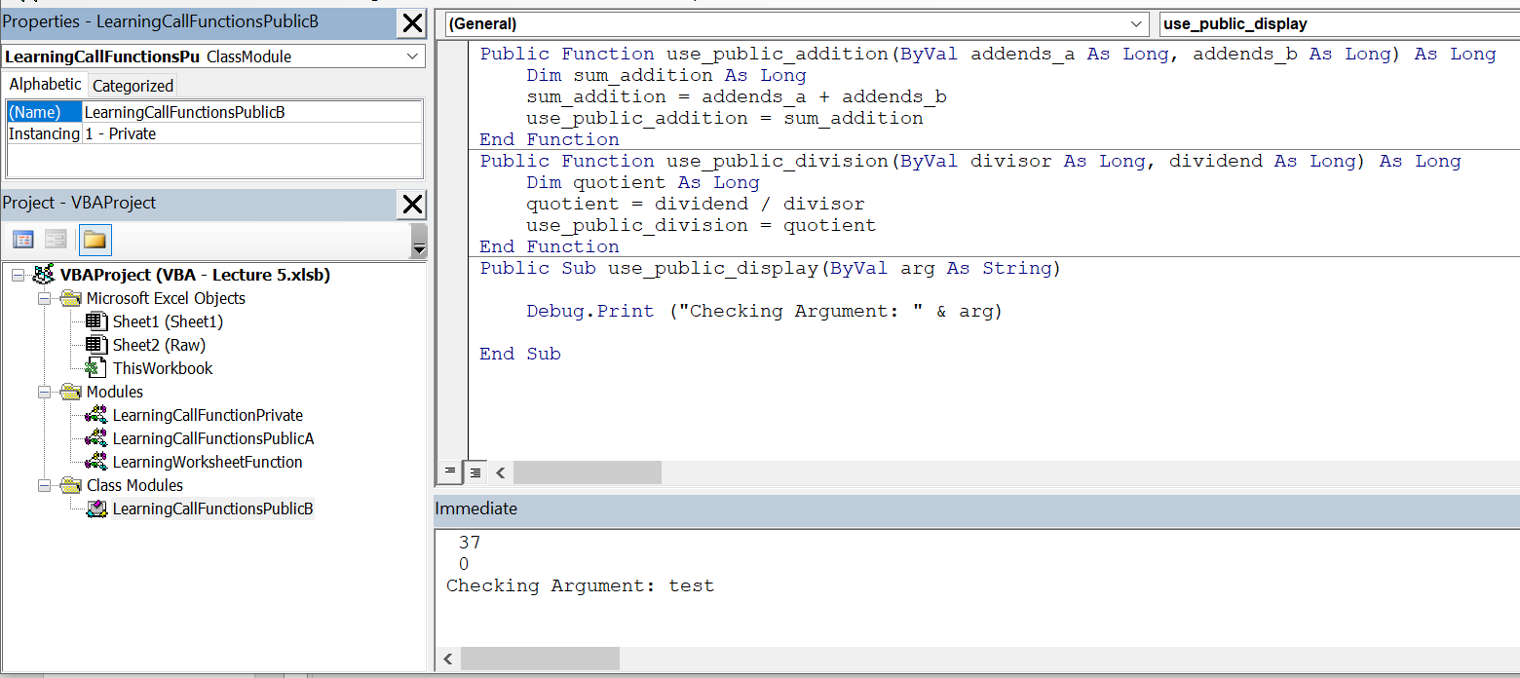
C.2. Public Subroutine/ Functions - available to all procedures in all modules in all applications
Class – With Functions

Slide 7
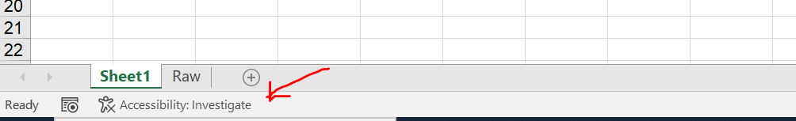
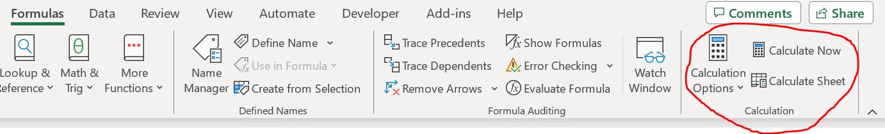
D. Speed up process VBA Application
d.1.) Application.ScreenUpdating - is a property used to avoid or prevent distraction flashes
while running the code and make it fast by turning off screen updating.
d.2.) Application.DisplayAlerts - this disables all alert messages. The user will not see any alerts or prompts,
and the default response is automatically chosen for any prompts that would have appeared.
d.3.) Application.DisplayStatusBar - used to control the display of the status bar in Excel.
d.5.) Application.Calculation - property in VBA is used to control the calculation mode in Excel.

Slide 8
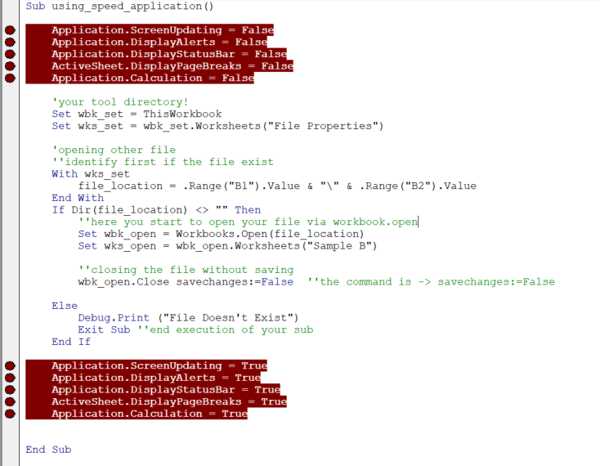
Sample:

Slide 9
30 mins review

Slide 10
Knowledge Check Quiz
5 Questions : )

